Slide 1
Athletics
1. Running
2. Jumping
3. Throwing

Slide 2
Running Events
Short distance running / Sprinting (100-200mt.)
Middle distance running (400-1500)
Long distance running (1500-42.195km)
Relay Race
Cross Country

Slide 3
Jumping Events
High jump
Skill ( Approach, Take off, Flight, Clearance, Landing)
Long Jump
Skill ( Approach, Take off, Flight, Landing)
Tripple Jump
Skill ( Approach, Take off, Hope, Flight, Landung)

Slide 4
Throwing Events
1. Shot put:-
Skill ( Holding, Stance, Gliding, Throwing, Reverse)
2. Javelin Throw:-
Skill (Grip, Carry, Approach, Throw, Reverse)

Slide 5
V0lleyball
1. Playing Area ( Length = 18mt. Breadth = 9mt. Line Breadth = 5cm)
2. Poles ( High = 2.55mt.)out of Center line 50/50 cm)
3. Net ( L. = 9.5mt. B.= 1mt and mesh = 10*10 sqr cm.)
height : Male = 2.43mt Female = 2.24mt.
4. Ball ( weight = 260-280grm. Circumference = 65-67 cm.)

Slide 6
Skill of Volleyball
Service
Passing :
Finger , Digging and One hand Digging
3. Raising : Finger, Digging
4. Spiking
5. Blocking
6. Placing

Slide 7
5. Players ( In Court 6 / 6 and Extra 6/6)
6. Antennas (1.80mt , 1mt net and 80cm net over
7. Official ( Referee =1, Umpire = 1, Scorer = 1 Linesmen = 2
Note ( Libero =1/1, Different Dress lives in court side )

Slide 8
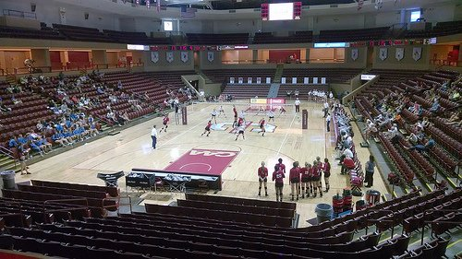

Slide 9
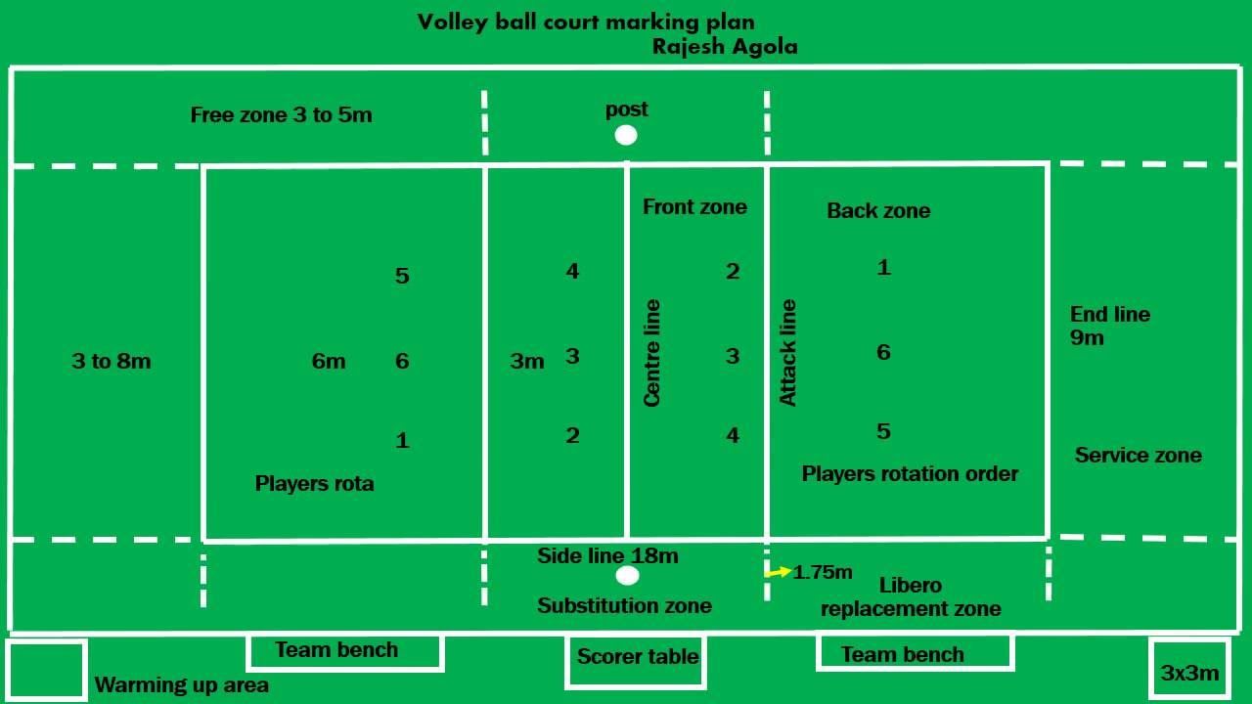

Slide 10
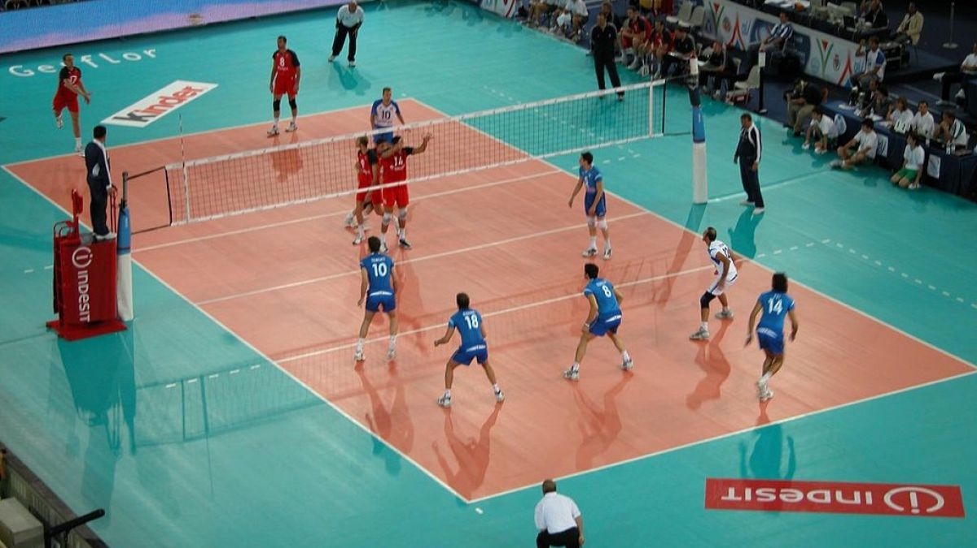

Slide 11
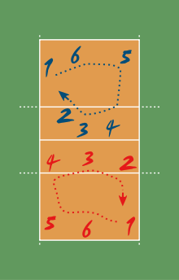

Slide 12
Kabaddi
Play ground :
Male ( Length = 12.5mt. Breadth = 10mt.)
Female ( Length = 11mt. Breadth = 8mt.)
Lobby = 1mt.
Sitting Block (male= 8mt. , Female = 6mt.
Player: In 7/7 and Extra: 5/5

Slide 13
Basic Skill of Kabaddi
Raiding ( Cant, Safe Raid, Dodge, Kick)
Trapping
Chaining
Lona ( Sing of Point)
Total Play Time : (40 minute Male)
(30 minute Female)
(15/20 minute Half and 5 minute rest)

Slide 14
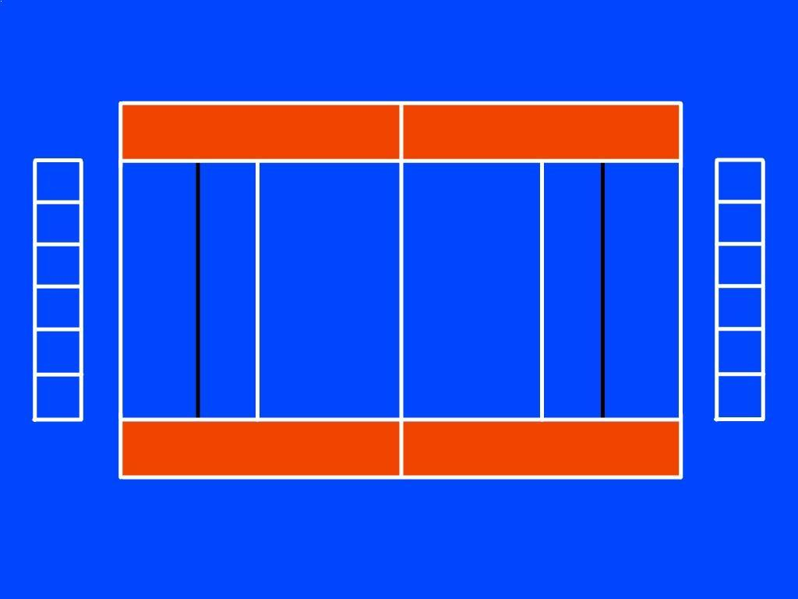

Slide 15
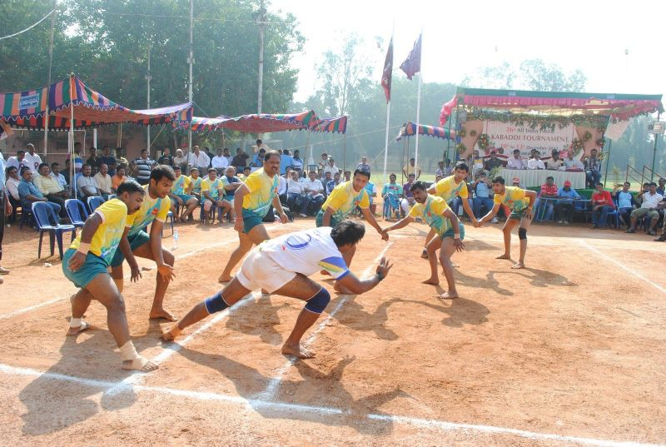

Slide 16
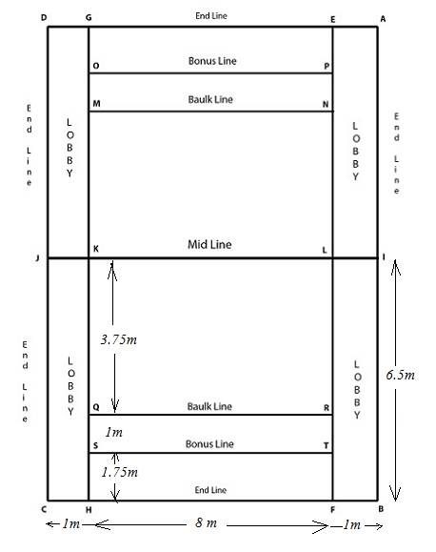

Slide 17
Skill of Kho kho
1. Chasing : ( Giving Kho, Taking Direction, Around the Post, )
2. Running

Slide 18
History of Kho Kho
v]nsf] pQklt / ljsfz ef/t af6 ePsf] xf] .
;g\ !(%% df ef/lto vf]vf] dxf;Fusf] :yfkgf (kho kho Federation of India)
of] v]n k|foM Asain Game and SAF df v]lnG5 . h:t} ef/t, g]kfn, kfls:tfg, >Lnªsf, ckmufg:yfg, e'6fg, cfbL
la=;= @)%@ ;fndf /fli6«o v]ns'b kl/ifb\ cGt{ut g]kfn vf] vf] ;+3sf] :yfkgf eof] .

Slide 19
Kho kho
!= v]nf8L ;+Vof M ( hgf # cltl/Qm
@= v]n ;do M #^ ldg]6 $ ×( r/0fdf v]lnG5 .
#= klxnf] xfk ( ld= kl5 % ld= cf/d km]/L ( ld=kl5 cf/d
$= (×( kl5 cyjf !* ld= kl5 xfkm M ( ld xfk

Slide 20
Officials of Kho kho
Referee : 1
Umpire : 1
Scorer : 1
Time Kipper : 1

Slide 21
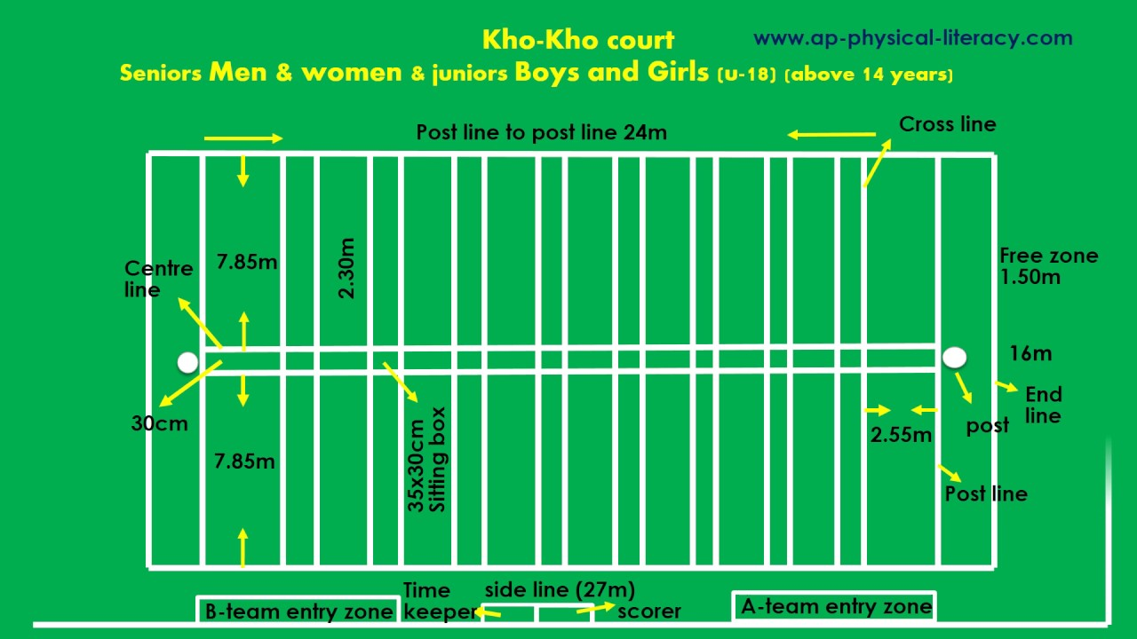

Slide 22
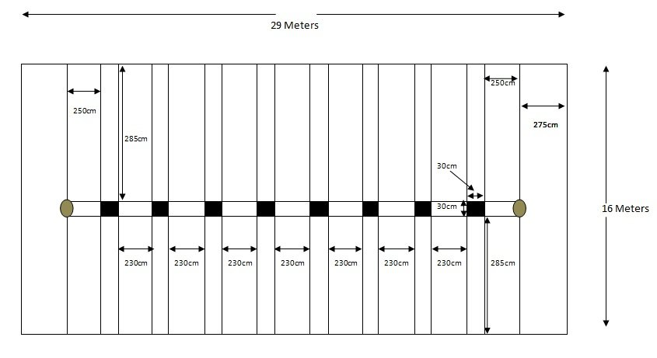

Slide 23
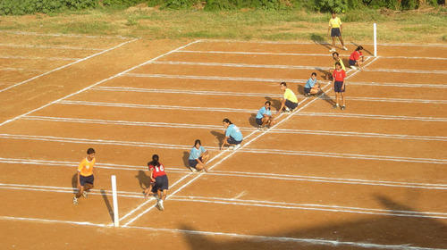

Slide 24
Physical Training P.T.
Instruction -lgb]{zg_
Command -cfb]z_
Action -sfo{ ug]{_

Slide 25
Drill
Instruction -lgb]{zg_
Command -cfb]z_
Action -sfo{ ug]{_

Slide 26
Commands of Drill
!= ;t{s ( Attention)
@=uf]8f kmf6 ( Stand at Ease)
#= sbd rfn ( Mark Time)
$= sbd yfd ( Halt)
%= 6f]nL la:tf/} cuf8L a9 ( Slow March)
^= l56f] lx8 ( Quick March)
&= bfofF kms{ (Right Turn)
*= afof kms{ (Left Turn)

Slide 27
(= k5f8L kms{ ( About turn)
!)= bflxg] ;/( Right Wheell)
!!=b]a|] ;/ ( Left Wheell)
!@= bflxg] x]/ ( Eyes Right)
!#= em08f ;dfTg] (Flag Holding)
!$= ;nfd lbg' ( Salute)
!%= nfOga agfpm (Fall in)
!^= glhs x'g' (Close up)
!&= ce/ ck (Cover up)
!*= lj;h{g (Dismiss)

