Slide 1
volleyball
Indo0r
Outdoor

Slide 2
History of Volleyball
elnan v]nsf] lasf; cd]/Lsf af6 ePsf] xf], ;g\ !(*% df
ljlnod hL df]u{g William G. Morgan
;g\ !($& df cGt/f{li6«o elnan ;ª3 :ykgf
k|wfg sfo{no k|mfG;sf] k]l/; zx/df
;g\ !($( df k|yd ljZa elnan cfof]hgf r]sf]:nf]eflsof sf] /fhwfgL k|udf ;DkGg ePsf] lyof] .
;g\ !(%@ df k|yd dlxnf elnan cfof]hgf ?;sf] df:sf] zx/df ePsf] lyof] .
lj=;= @)## df g]kfn elnan ;ªsf] :yfkgf

Slide 3
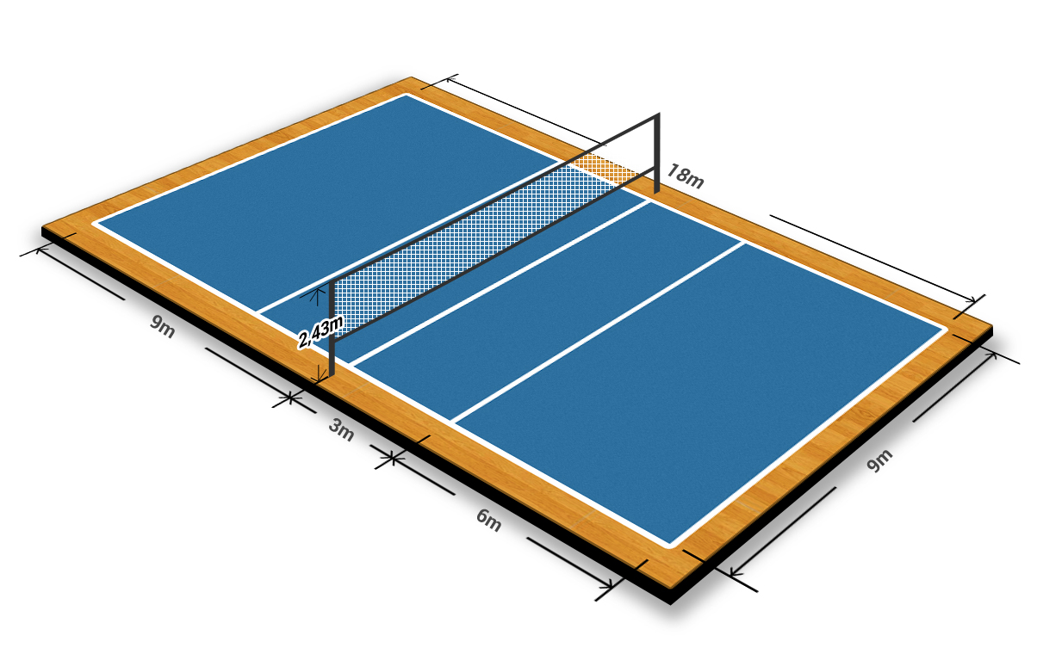
Court of volleyball

Slide 4
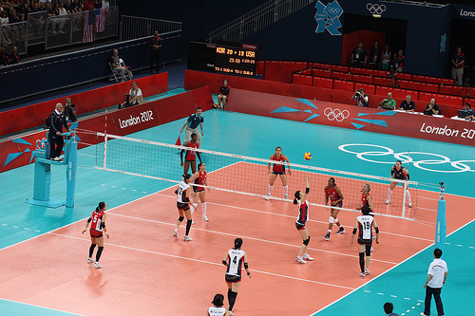
Game of Volleyball

Slide 5
Importance key of Volleyball
Court: Net :
Length : 18 M. Length : 9.5 M.
Breadth : 9 M. Breadth : 1 M.
Pole hight : 2.55M. Mesh : 10× 10 cm
Circumference 65 – 67 cm High : Male : 2.44 m.
Weight of Ball : 260 – 280 g. Female 2.24 m
Length of Antenna : 1.80 M Player : 6/6

Slide 6
Officials – 5
Referee : 1
Umpire : 1
Scorer : 1
Linesmen : 2
Total : 5

Slide 7
Main Skill of Volleyball
Service
Digging
Passing
Raising
Spiking
Blocking
Placing

Slide 8
Officiating of Volleyball
!_ ansf] clwsf/
@_ ;le{; ug{sf nflu lbOg] ;ªs]t
#_ an aflx/ hfg'
$_ annfO{ $ k6s 5' g'
%_ ;femf an (_ xf]lN8ª
^_ g]6 6r !)_ b'O k6s xfGg'
&_ 6fOd cfp6 !!_ sf]6{ abNg]
*_ an l7s 7fpFdf v;]sf] !@_ an cfp6

