Slide 1
Unit :3 Prevention of Non-Communicable Diseases (g;g]{ /f]ux?sf] /f]syfd)
3.1 Concept of non-communicable disease -g;g]{ /f]usf] cjwf/0f_
3.2 Levels of prevention of non-communicable disease -g;g]{ /f]u/f]syfdsf tx÷r/0fx¿_
1. Primordial Prevention -lk|df]l8{on /f]syfd_
2. Primary Prevention -k|f/lDes r/0fsf] /f]syfd_
3. Secondary Prevention -bf];|f] r/0fsf] /f]syfd _
4. Tertiary Prevention -t];|f] r/0fsf] /f]syfd_
Page 1

Slide 2
Control of all Non communicable Disease
Control of smoking
Control of obesity
Control of stress
Provision of nutrition education
Nutrition policy of the state government
Healthy lifestyle
Improvement of housing
Prevention and control of environmental pollution
Page 2

Slide 3
3.3 Cancer -ca'{b_ Causes sf/0f
!= jftfj/0fLo tTjx¿ (Environmental Factors)
@= ;'tL{ (Tobacco)
#= dBkfg (Alcohol) Page 3
$= kYo;DalGw tTjx¿ (Dietary factors)
%= Jofj;floss sf/0fx¿ (Occupational Exposures)
^= ljiff0f'x¿ (Viruses)
&= k/hLjLx¿ (Parasites)
*= cGo -/Lltl/jfh, afgL tyf hLjgk4tL_ (Others: Customs, Habits and life styles)
@= j+zfg'qmd (Genetic factors)

Slide 4
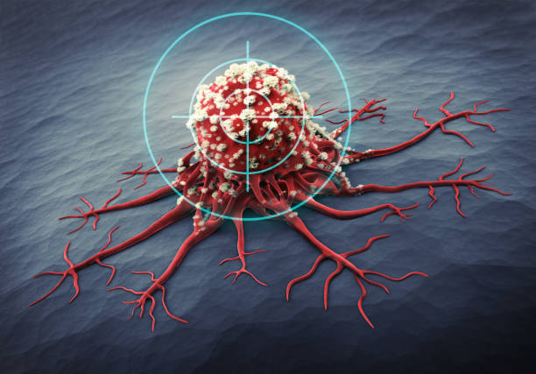
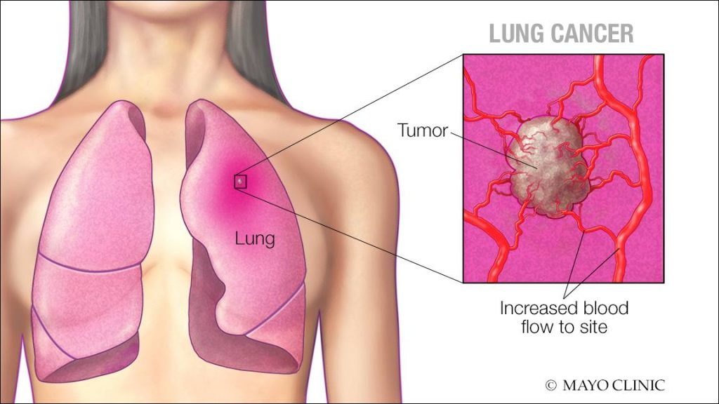
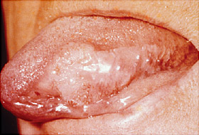
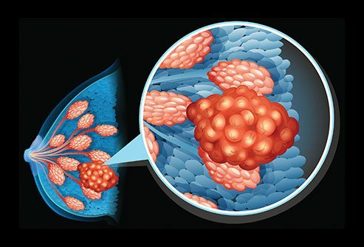

Slide 6
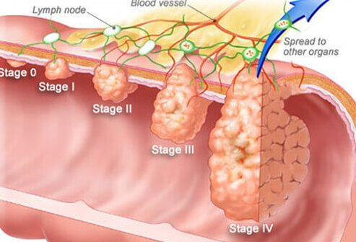

Slide 7
nIf0fx¿
!= :tgd s8f ufF7fu'F7L cfpg' .
@= z/L/df ePsf sf]7L jf d';f df kl/jt{g cfpg' .
#= kfrg k|0ffnL tyf lb;f ug]{ afgLdf kl/jt{g cfpg' .
$= nfdf] ;do;Dd vf]sL nfUg' jf :Jf/ g/fd|f] x'g' .
%= dfl;s;|fj xF'bf jf cGo ;dodf eGbf a9L /Qm;|fj x'g' .
^= s'g}}} ;'lgPsf] jf 3fp ePsf] 7fpF nfdf] ;do;Dd pkrf/ ubf{ lgsf] gx'g' .
&= ljgfsf/0f tf}n 36\g' . Page 4
*= s'g} k|fs[lts Kjfnaf6 /Qm;|fj x''g' .
(= sf]ifx¿sf] c;fdfGo lsl;dn] j[l4 x''g .

Slide 8
/f]syfd / lgoGq0fM
!= JjlQmut :Jf:ys/ afgLsf] ljsf; ug'{k5{ .
@= z/L/df rf]6 k6s nfUg uPdf To;sf] ;dod} pkrf/ u/fpg'k5{ .
#= :yfoL lsl;dsf] slAhot x'g uPdf To;sf] t'?Gt pkrf/ u/fpg'k5{ .
$= #% jif{dflysf pd]/–;d"xsf JolQmn] jif{sf] Ps k6s :Jff:Yo k/LIf0f u/fpg'k5{ .
%= jftfj/0fLo ;/;kmfOdf a9L Wofg k'¥ofpg'kl5{.
^= aRrfx¿nfO{ cfˆg} cfdfn] :tgkfg u/fpg'k5{ . Page 5
&= SofG;/ /f]uaf/] hg;fwf/0fnfO{ :Jff:Yo lzIff lbg'k5{ .

Slide 9
3.3 Heart Diseases -d'6'sf /f]ux¿_
Hypertension -pRr /Qmrfk _
Coronary Heart Diseases
Rheumatic Fever
Page 6

Slide 10
pRr /Qmrfk M
k|foM $% jif{ dfly pd]/ ePsf
;fdflhs, cfly{s ;DkGg, al9 kf}li6s cfx/ ;]jg ug]{
zf/Ll/s Jofd gug]{
ljnfl; lhjg ljtfpg]
pd]/ a9\b} hfbf d'6' tyf dlitissf wdlgx? s8f x'g] h;n] ubf{ /Qmrfk a9\b} hfG5
;fdGo /Qmrfk eGbf al9 ePdf pRr /Qmrfk elgG5 .
s'g} nIf0f b]vfpb}g
Silent Killer Page 7
d'6', cfvfF, lduf}{nf , dlitis df cfqmd0f

Slide 11
Causes of Hypertension:
Age -pd]/_
Genetic factor -j+zf0ff‘qmd tTj_ Page 8
Obesity -e2fkg jf df]6f]kg_
High salt intake -g'g a9L vfg' _
Physical Activity -zf./Ll/s lqmofsnfk_
Environment stress -jftfjj/0fLo tgfj_
other factors -cGo tTjx?_
Alcohol and smoking -dBkfg / w|'dkfg_

Slide 12
Symptoms of Hypertension
l/Fuf6f nfUg'
6fpsf] b'Vg'
sdhf]/ x'g'
/f]uL rfF8} yfSg'
/f]uLnfO kl;gf cfpg'
d'6' xNn]sf] cg'ej x'g'
Page 9

Slide 13
Prevention of Hypertension:
lbgdf * b]lv !) 306f cf/fd ug'{k5{ .
w'd|kfg / dBkfg ug'{ x'b}g .
g'g, d;nf, crf/ cldnf] sd vfg] .
tf}n sd ug]{ .
ljxfg a]n'sf :jR5 7fpFdf 3'Dg] .
k|f]l6g / lrNnf] k4f{y sd vfg] .
lgoldn /Qmrfksf] kl/If0f ug]{ .
Page 11

Slide 14
Coronary Heart Disease sf]/f]g/L x[bo /f]u M
;a}eGbf al9 ;ª\Vofdf nfUg] /f]u
wdlgx?df af];f] hDdf x'g uP/ s8f kg tyf cj/f]wn]
d'6 df k|foM /ut cfk"lt{ gx"bf d[To" x'g]
x[bo3ft Heart Attaack
!) k|ltzt ;"?df % k|ltzt Page 12
k|foM ljslzt /fi6«x?df a9\bf] qmddf 5 .
WHO @)@) ;Dddf s/La @ s/f]8 %) nfv k'Ug] dg]{
Risk Factors elgG5 .
cem} ;Dd klg s'g} sf/0f kQf nfUg g;]s]sf] .

Slide 15
Causes of CHD :
Smoking and Alcohol
Hypertension
Cholesterol : Fat, Egg, Ghee,
Diabetes
Genetic Factors
Physical Activity
Hormones
Page 13

Slide 16
Prevention of CHD:
/QmrfknfO{ lgoGq0f ug]{
dw'd]x 5 5}g k/LIf0f ug]{
wd|kfg gug]{
sf]n]:6]/f]n af6 aRg]
tgfj glng]
dBkfg eP t'?Gt 5f]8\g] Page 14
;dod} pkrf/ ug]{
:Jf:Yo lzIff lbg]
;fu;AhL kmnk'mn u]8fu'l8 w]/} vfg]

Slide 17
Rheumatic Fever ?d]l6s Hj/f]M
d'Votof , hf]gL{ / tGt'df k|efj kf5{
u|'k P a]6f x]df]nfol6s :6]«K6f]sf]s; n] ubf{
;?jf /f]u xf]Og Page 15
k|ofM cljslzt d'n'sx?df b]vf k5{
% jif{ b]lv !% jif{ ;d"xsf afnaflnsfdf al9 k|efljt
%) k|ltzt eGbf al9sf] d'6'sf eNe?sf] v/fa
u/LaL eL8ef8 Go"g cfxf/ ljsf/ ckof{Kt :Jff:Yo ;]jf

Slide 18
Causes of Rheumatic Fever :
Group 'A' Beta Haemolytic Streptococcus
u|'k P a]6f x]df]nfol6s :6]«K6f]sf]s;
Page 16

Slide 19
Symptoms of Rheumatic Fever:
al9 dfqfdf kl;gf cfpg' tyf 3fl6 3;v;fpg'
hf]gL{ 3'F8f, s'Ogf, gfl8, uf]lnuf7f] x?df ;ª\qd0f x'g'
lt cËu b'Vg' tyf ;'lGgsg' Page 17
d'6'sf] df+zk]zLx? j[l4 x'g'
bd a9\g' 5ftL b'Vg' skmdf /ut cfpg'
5fnfdf glrnfpg] ;kmf ljlj/f cfpg'
WBC j[l4 x'g'

Slide 20
RheuPrevention and Control of matic Fever :
k|f/lDes r/0fd} pkr/ ug]{
/f]luaf6 cfPsf] kmf]xf]/ kbf{y{ plrt tj/n] lj;h{g ug]{
ljBfno afnaflnsf?nfO al9 Vofn ug]{
:jf:y lzIff lbg] Page 18
;do ;fod} s]6fs]6Lx?sf] :jf:y hfFr ug]{
;Gt'lnt cfxf/ v'jfg]
d'6' xNn]g] ZofFZofF ug]{ s]6fs]6Ln] ljz]if1 af6 pkrf/ ug]{

Slide 21
Diabetes/ Mellitus: -lrlgsf] /f]u dw'd]x_
lrgL /f]u k|foM ;a} b]zx¿df kfOG5 . ljZjdf sl/j # s/f]8 eGbf al9 dflg; o; /f]uaf6 u|l;t 5g\ . lj1fg / k|ljlwsf] ljsf;n] ubf{ cfw'lgs hLjgz}nL, clgolGqt vfgkfg, ljnf;Lk"0f{ hLjgofkgn] ubf{ of] /f]u b]vf kb{5 . of] /f]u k|foM s/La $) jif{ k5L b]vf kb{5 . o;nfO{ Slow killer klg elGg5 .
cfdfzo leq KoflGqmofh gfdsf] u|lGy x'G5, h;n] OG;'lng gfdsf] xdf]{g tof/ ub{5 . o; xdf]{gn] /undf ePsf] Un'sf]hnfO{ k|of]udf NofP/ zlQm k|fKt ub{5 . olb OlG;'g sd dfqdf aGg yfn]df jf sdhf]/ ePdf o;n] /utdf ePsf] Un'sf]hnfO{ zlQmdf kl/0ft ug{ ;Sb}g t;y{ /utdf Un'sf]hsf] dfqf a9\g hfG5, o:tf] cj:yfnfO{ lrgL /f]u elgG5 . Page 1

Slide 22
Types of Diabetes/ Mellitus: -lrlg /f]usf k|sf/x? _
Insulin Dependent Diabetes/ Mellitus : Type 1 - OG;'lngdf cfl>t x'g] lrlg /f]u_
o; k|sf/sf] /f]lux?df /f]usf nIf0fx? crfgs b]vf kb{5g\ . /f]lu k|foM b'Anf ktnf / sd pd]sf x'G5g\ . o; k|sf/sf] lrgL /f]udf OG;'lng ;'O{sf] k|of]uaf6 dfq /f]lusf] /utdf lrlgsf] dfqf lgoGq0fdf /fVg ;lsG5 .
Non-Insulin Dependent Diabetes/ Mellitus : Type 2 - OG;'lngdf cfl>t gx'g] lrlg /f]u_
o;df /f]usf nIf0fx? lj:tf/} lj:tf/} b]vfkb{5 . o:tf /f]lux? df]6f3f6f tyf cln j[4 cj:yfsf x'G5g\ . o; k|sf/sf] lrlg /f]udf /f]lux?n] vfgkfgsf] lgoGq0f tyf vfg] rSsLsf] k|of]uaf6 lgoGq0f ug{ ;S5g\ . Page 2

Slide 23
Causes of Diabetes -lrlg /f]usf sf/0fx? _
Sedentary Life Style (lgliqmo hLjg k4lt)
Diet (v'/fs)
Malnutrition (vfgfdf k|f]l6gsf] cefj jf s'kf]if0f)
Excessive Intake of Alcohol(cToflws /S;Lsf] ;]jg)
Viral Infections( ljif0f'sf] ;ªqmd0f)
Chemical Agents ( cf}ifwLx?sf] sf/0fn])
Other Factors (cGo tTjx?) Page 3

Slide 24
Symptoms of Diabetes -lrlg /f]usf nIf0fx? _
Kof; a9L nfUg'
lk;fa w]/} x'g' .
ef]s w]/} nfUg' .
z/L/sf] tf}n 36\g' .
sdhf]/L dxz'; x'g' jf a9L ysfO{ nfUg'
5fnf;DalGw /f]ux¿ af/Daf/ b]vf kg'{ .
z/L/df 3fp– vl6/fx¿ nfdf] ;do ;Dd lgsf] gx'g' .
z/L/sf] 5fnf ;'Svf x'g' ;fy} lrnfpg' .
cfFvfsf] b[li6df u8a8L x'g' .
xft – v'§f emdemdfpg' . Page 4

Slide 25
Prevention and Control of Diabetes -lrlg /f]usf] /f]syfd tyf lgoGq0f_
/f]uaf/] /fd|f] k/fdz{ ;]jf lbg'k5{ .
cfdfafa' b'j}df of] /f]u b]lvPdf ;Gtfg hGdfpg] ljrf/ gug'{ /fd|f] x'G5 .
/f]lu ;s];Dd 3fp, rf]6k6s cflbaf6 hf]lug'k5{ .
Un'sf]h al9 ePsf] vfgf vfg' x'b}g .
dBkfg / w'd|kfg ;]jg ug'{ x'b}g . Page 6
plrt zf/Ll/s cEof; ug'{ ,
h'g kfof] ToxL cf}ifwLsf] ;]jg ug'{ x''b}g .
hLjgz}nL / vfgfsf] plrt Joj:yfkg ug'{k5{ .
cª\u'/, cgf/, s]/f, cfFk cflb h:tf kmnk'mn h;df lrgLsf] dfq a9L x'G5 vfg' x'b}g .

Slide 26
Causes of Gastritis:
clgoldt ?kdf vfgf vfg' .
r'/f]6, tdfv' w'd|kfg / dBkfg sf] nt a:g'
ljiffn' vfgfsf] ;]jg
clgoldt ?kdf kflgsf] ;]jg
vfgf slxn] al9 slxn] sd vfg]
t/sf/L / kmnk'mn sd vfg] Page 7
zf}rfno clgoldt x'g'
zf/Ll/s ;/;kmfO{ sdL x'g'
lgGb|f tyf cf/fdsf] cefj x'g'
dfgl;s tgfj, l/;, 8fxf lng'

Slide 27
Symptoms of Gastritis :
k]6 b'Vg'
jfs jfs nfUg'
k]6 k'mNg'
vfgf vfg dg gnfUg] Page 8
Hj/f] cfpg'
slxn]sflx afGtfdf /ut b]lvg'
5flt kf]n]sf] cg'ej x'g'
;dod} pkrf/ geP lbzfdf /ut b]lvg'
hf8f] ePsf] cg'ej x'g'

Slide 28
Prevention of Gastritis:
lgoldt ?kdf vfgf rkfP/ vfg]
vfgf vfbf c? s'/fdf Wofg glbg]
vfPsf] vfgf klr;s]k5L dfq csf]{ vfgf vfg]
ef]s nfu]kl5 dfq vfgf vfg]
vfgfdf ld;fj6 u/]/ vfg' x'b}g
xl/of] ;fu;lAh, df};d /;o'Qm kmnk'mn al9 vfg]
dfgl;s lrGtf glnO cf/d ug]{
u]8fu'8L lehfP/ 6'';f pdf/L vfg]
lrof slkm r'/f]6 lr;f] /lS; sd ;]jg ug'{
zf/Ll/s Jofod ug]{ Page 9
vfln k]6 nfdf] ;do ga:g]
/f]usf] z+sf nfUgf;fy t'?Gt} pkrf/ ug]{
:jf:y lzIff ;DalGw lzIff lbg]
tf/]sf] e'6]sf] cldnf] d;nf kL/f] al9 vfg' x'b}g

Slide 29
Causes of Ulcer
j+zh
Pl;8 tyf k]lK;gn] cfdfzosf] Do'sf];nfO{ vfOlbPk5L
al9 dfqfdf Uofl:6s /;sf] pTkfbg x'g'
al9 zf/Ll/s / dfgl;s lrGtf lnPdf
;dodf vfgf gvfg' Page 10
al9 dfqdf lrNnf] lk/f] d;nf cldnf] vfPdf
w'd|kfg / /l'S;sf] al9 ;]jg u/]df

Slide 30
Symptoms of Ulcer
k]6df s'g} lrhn] sf]tf/]sf] jf kf]n]sf] h:tf] x'g'
k|foM /flt d'6'lt/ al9 b'v]sf] cg'ej x'g]
vfln k]6 ePsf] a]nf cldnf] kflg cfpg'
jfsjfsL nfUg', afGtf x'g', tyf 5flt kf]Ng'
slxn]sflx afGtfdf /ut b]lvg'
b'Anfpb} hfg] vfgf dg gnfUg]
k]6sf df+zk]zL s8f x'g' Page 11
k|foM h;f] k]6sf] dflyNnf] efudf b'Vg'
cN;/n] s8f x'g uodf lbzf cnsqf h:tf] sfnf] x'g'

Slide 31
Prevention of Ulcer:
zf/Ll/s tyf dfgl;s tgfj glng]]
t/ sf6]sf] b'w vfg'k5{
cf/fd ug'{k5{
vfln k]6 ga:g] ;do ;dodf yf]/} yf]/} vfgf vfO/xg]
PG6fl;8 cf}iflw vfg'k5{
dBkfg / w'd|kfg vfg'x'b}g
zf/Ll/s Jofd ug]{ Page 13
/f]u nfUgf;fy t'?Gt} 8S6/sf] ;Nnf cg';f/ cf}iflwsf] vfg]

Slide 32
bdsf] /f]uM (Asthma)
of] /f]u :jf;k|:Jf; ;DalGw /f]u xf] . xfd|f] z/L/nfO{ rflxg] clS;hg O2 lng] / sfa{g8fOcS;fO8 CO2 UofF; ˆofSg] lqmof :jtM ;~rfng eO/x]s]f xG5 . z/L/sf k|To]s cË tyf sf]ifx?nfO{ O2 sf] cfjZostf kb{5 . olb lo sf]if tyf tGt'x¿df O2 sd eof] eg], O2 sf] nflu Zjf; k|Zjf; b/ a9\b} hfG5 o;nfO{ g} ;fdfGo efiffdf bdsf] /f]u elgG5 .
Causes:
kmf]S;f]s]f sf/0f M kmf]S;f]sf] Ifo/f]u, lgdf]lgof, w'nf]–w'jf, kmf]S;f]df kfgL el/gfn], cflb .
d'6' /f]usf] sf/0f M d'6';DalGw /f]ux¿
dfgl;s c;Gt'ng M dfgl;s tgfj, eo, zf]s qmf]w cToflws lrGtf cflb dv Page 14

Slide 33
Symptoms:
crfgs ;fdfGo cj:yfaf6 /f]usf] cj:yfdf k'Ug' .
/f]lusf] 5flt sl;Psf] cg'ej x'g' .
;'Vvf vf]sL nfUg' .
Zjf; k]mg{ sl7g x'g' .
Zjf; lnbf ;'OF–;'OF cfjh lgsfNg' .
/f]lu lgnf] b]lvg' .
d'6'sf] w8\sg a9]/ cfpg' .
/f]ludf WBC sf] ;ª\Vof j[l4 x'g' . Page 15

Slide 34
Prevention and Control:
/f]lunfO{ lr;f]af6 arfpg'k5{ .
/f]lun] tftf] kfgL vfg] tyf tftf] kfgLn] g'xfpFg' k5{ .
/f]lu k|foM w'nf w'jfF ePsf] 7fpFdf hfg' x'b}g .
/f]lun] s'g} lrh vfgfn] jf ;Dks{df cfpFbf bd a9\5 eg] To;af6 aRg'k5{ . Page 16
w'd|kfg / dBkfg ;]jg ug'{x'b}g .
lrlsT;s ;Nnfx cg';f/ cf}iflw ;]jg ug'{k5{ .
dfgl;s tgfj, kL/, lrGtf eo cflb af6 d'Qm x'g'k5{ .
/f]lunfO{ bd cfpg] k"j{;ª\s]t kfpg ;fy c:kftfn n}hfg'k5{ .

Slide 35
Arthritis -afysf] /f]u_
afy /f]u eGg] zAb b'O{j6f zAbx? ldn]/ ag]sf] 5 . h:t} cy{ -Arth_ sf] cy{ hf]gL{ / cfOl6;-ltis_ sf] cy{ Hjng jf ;'lGgg' x'G5 . To;}n] afy /f]unfO{ hf]gL{ b'Vg], ;'lGgg] tyf km'Ng] /f]u eGg] u/]sf] kfOG5 . o; k|sf/sf] /f]u pTkGg ug]{ vf;} /f]usf sf/s tTj clxn];Dd s'g} klg lrlsT;fsdL{x?n] kQfnufpg ;s]sf] 5}gg\ . of] /f]un] k|foM u/]/ k}FtfnL; aif{eGbf dflysf g/gf/Lx?nfO{ cfqmd0f u/]sf] kfOP klg afnaflnsx¿nfO{ klg nfUg ;S5 . afy /f]u nfO{ b'O{ k|sf/df ljefhg ul/Psf] 5 . Page 1

Slide 36
!= ¥o'df6\jfO8 cy{/fOl6; (Rheumatoid Arthritis)
of] h'g;'s} hnafo' tyf hghfltsf] ;d'bfodf nfUg] u5{. of] /f]u k'?ifdf eGbf dlxnfdf tLg u'0f a9L nfUg] u5{ . o;n] al9 lr;f] 7fpFdf a;f]af; ug]{x¿nfO{ al9 cfqmd0f ub{5 .
Causes:
j+zf0f'ut
hf]gL{sf] ;ª\qmd0f Page 2
ODo'gf]Unf]j'lng P cflb

Slide 37
Symptoms of Rheumatoid Arthritis
xftv'§fsf cf}nfx¿sf hf]gL{x¿, gf8Lx¿, k}tfnf, uf]lnufF7fx¿ tyf sfFwsf hf]gL{x¿ ;'lGgg' .
Hj/f] cfpg', vfgf vfg dg gx'g', dfF;k]zL b'Vg' .
/f]lusf] tf}n 36\g' tyf ysfO nfUg' .
xftsf cf}nfx¿ s'lxg', ;'lGgg' / s'?ktf b]lvg'
/f]lusf] 3fF6L tyf sDd/ b'Vg' .
hf]gL{sf] ultdf dGb cfpg' .
o;sf] s8f ?kn] qmdz /Qm;~rf/, Zjf;–k|Zjf; tyf :gfo' k|0ffnLdf ;d]t c;/ kg'{ . Page 3

Slide 38
Prevention and Control of Rheumatoid Arthritis
/f]lunfO{ kof{Kt zf/Ll/s cf/fdf lbg'k5{ .
hf]gL{ g;'lGgg] jf gb'Vg] cf}ifwLx¿ lng'k5{ .
lkmlhof]y]/fkL u/fpg'k5{ .
/f]lunfO{ lr;f]af6 arfpg'k5{ .
/f]lun] dBkfg tyf w'd|kfg ;]jg ug'{ x'b}g .
o; /f]uaf/] jf:tljs 1fg lbg'k{ .
Page 4

Slide 39
@= cf]l:6of] cy{/fOl6; (Osteoarthritis)
of] s'/s/] xf8, k'6\7fsf] xf8, 3'F8f sf hf]gL{x¿df nfUg] afy /f]u xf] . k|foM $% jif{dflysf o'jfo'jtLx¿df nfUg] u/]s]f kfOG5 . o; /f]unfO{ X-ray sf] dfWodaf6 kQf nufpg ;lsG5 .
Causes Page 5
hf]gL{sf] 3fp tyf rf]6k6sn] ubf{ .
d'6', d"qfzo tyf 6fpsfsf] 3fpn] ubf{ .
cToflws zf/Ll/s Jofofd, clgb|f, cToflws /ltlqm8f ug]{ afgL .
j+zf0f'qmd tTj tyf ;Gt'lnt cfxf/sf] cefj cflb .

Slide 40
Symptoms of Osteoarthritis
hf]gL{sf] aLrsf] efu ;fF3'/f] x'b} cfpg' .
hf]gL{jl/kl/sf s'/s'/] xf8x?sf] Ifo x'g' .
k'6\7fsf] hf]gL{sf] ;ªqmd0fn] Joltmn] cfˆgf] zf/Ll/s jhg yfDg g;Sg' . Page 6
hf]gL{df /x]sf] t/n kbfy{ ;'Sb} hfg' .
xf8 v;|f] x'g'sf ;fy} a9L dfqfdf b'Vg' .
/f]uL lxF88'n ug{ g;Sg' .
;ª\qmldt cª\u rnfpFbf s6–s6 cfjfh cfpg' OToflb .

Slide 41
Prevention of Osteoarthritis
/f]uLn] lgoldt ?kdf plrt Jofod ug'{k5{ .
/f]usf] zf/Ll/s tf}n a9L ePdf qmlds ?kdf 36fpb}F hfg'k5{ .
;Gt'lnt ef]hgsf] ;]jg ug'{k5{ .
hf]gL{df tftf] ;]sfO ug'{k5{ . Page 7
lr;f]af6 aRg Gofgf] sk8f nufpg'k5{ .
hf]gL{, 6fpsf], d'6' tyf d"qfzosf] rf]6 tyf /f]u nfu]sf zªsf nfu]df t'?Gt pkrf/ u/fpg'k5{ .
/f]uLnfO{ lxF88'n ug{sf nflu n7\7L -Walking stick_ pknAw u/fpg'k5{ .
/f]uLnfO{ lrlsT;f ;]jf pknAw u/fpg'k5{ .

Slide 42
kTy/L -Stones_ b'O{ k|sf/sf] 5 . != lkQsf] kTy/L -Gall Stone @= lduf]{nfsf] kTy/L (Kidney Stone)
!= lkQsf] kTy/L -Gall Stone_ Page 8
lkQ sn]hf]n] agfpg] xl/of] /ªsf] Ps k|sf/sf] t/n kbf{y xf] . of] sn]hf]df alg;s]kl5 lkQy}nLdf hDdf x'G5 . lkQn] vfgf krfpg dbt u5{ . xfldn] vfPsf] vfgf ;fgf] cfGb|fdf k'u]k5L lkQy}nL v'DrG5 / lkQgln x'b}F ;fgf] cfGb|fdf k'U5 . d'Vo u/]/ lkQn] lrNnf] kbfy{, le6fldg, vlgh tTj krfpg] sfd ub{5 . lkQ /;df kfgL, nj0f, sf]n]:6]/f]n, SoflN;od tyf cGo tTjx¿ h'g sn]hf]n] aflx/ lgsfNg] b'lift kbfy{ cflb /x]sf x'G5g\ . sf]nf]:6]/f]nsf nj0fx¿ afSnf] x'g uO{ To;af6 9'ª\uf aGg hfG5 . olb lkQdf 9'ª\uf alg;s]kl5 pQm 9'ª\ufn] lkQgln aGb x'bfF si6 al9 x'G5 . olb nfdf] ;do ;Dd lkQy}lndf kTy/ /xg uPdf SofG;/ x'g ;Sg] ;Dejgf a9\5 .

Slide 43
Causes of Gall Stone
d'Vo cª\u|hL F cIf/ rf/ ePsfnfO{ nfUg] u5{
dlxnf (Female) M ()Ü dlxnf al9 u|l;t xG5g\, sf/0f dlxnfx¿df af];f]sf] dfqf al9 x'G5 .
df]6f] (Fatty) M df]6f] JolQmdf ;Dejgf al9 x'G5 . p;df sf]nf]:6]/f]n al9 x'g' .
rfln; (Forty) M k|foM $) jif{ dflysf nfO{ b]lvG5 .
pj{/f (Fertile) M ;'Ts]/L ;dodf l3p, Hjfgf], af];f]o'Qm df;' , rfs' al9 vfgfn]
cGo, Page 9
lkQsf] ;~rf/df cj/f]w
clgoldt vfgkfg
;fukft tyf vfg]kfgLsf] v/faLaf6
6fOkmfO8 /f]usf] cfqmd0fn] ubf{ .

Slide 44
Symptoms of Gall Stone
vfgf vfO;s]kl5 k]6sf] bfofF efusf] cln dfly b'Vg' .
lrNnf], af];f], / e'6]sf] kbfy{ vfbf ckr x'g' .
cfFvf tyf 5fnfdf hlG8;sf nIf0fx¿ b]lvg' .
/f]lunfO{ k|foh;f] Hj/f] cfpg' .
slxn]sfxL 9'ª\uf lg:sg] k|oTg ePdf a9L b'Vg' .
lkQy}nL kfSg uPdf k]6df ;'lGgPsf] 8Nnf] aGg' .
Page 10

Slide 45
Prevention and Control of Gall Stone
w]/} lrNnf], tf/]s]f / af];f] vfg' x'b}g .
;fwf vfgf / ;kmf kfgL vfg]
zNolrlsT;f u/L l56f]eGbf l56f] kTy/ lgsfNg'k5{ .
/f]lun] plrt pkrf/ ug{k5{ .
Page 11

Slide 46
@= lduf]{nfsf] kTy/L (Kidney Stone):
d"q k|0fnLdf kTy/ aGg'nfO{ d"q kTy/L elgG5 . d"q k|0ffnL cGtu{t lduf}{nf, d"qgnLx¿, lk;fay}nL / d"qåf/gnLdf kTy/L aGg ;S5 . lduf}{nfsf] kTy/LnfO{ 'Renal Stone" kgL elgG5 . lduf}{nfsf] kTy/L dlxnfsf] t'ngfdf k'?if al9 dfqfdf b]lvG5 .
Page 12

Slide 47
Causes of Kidney Stone
lk;faaf6 a9L dfqfdf Calcium oxalate, cystine, uric acid cflb lg:sg' .
le6fldg 'C' sf] dfqf a9L x'g' / le6fldg 'A' sf] dfqf sdL x'g' .
d"qdfu{sf] ;ª\qmd0f / lk;fa ˆofSg] dfu{df u8a9L x'g' .
j+zhsf] u8a9L x'g' .
lgl:s|o hLjg–k4lt ckgfpg' .
cGo sf/0fx¿df kfgL sd vfg', lk;fa /f]Sg', 6d6/ kfn'ª\uf], kfg, ;'kf/L, slkm, lrof,r"g, cflb a9L dfqfdf vfg' . Page 13

Slide 48
Symptoms of Kidney Stone
kTy/ d"qgnLaf6 lg:sg nfUbf a9L b'Vg' .
lk;faaf6 /utsf] s0fx¿ b]lvg' .
clgoldt 9ª\uaf6 Hj/f] cfpg' .
jfsjfs / jfGtf x'g' .
kTy/L ePsf] cË ;'lgg' .
vfgf vfg dg gx'g' .
k6s k6s lk;fa nfUg' .
sDd/ / lk7\oF" b'Vg' .
o;sf] hl6n nI0fdf lk;fa sdL x'g', /Qmrfk a9\g' / lduf}{nfn] sfo{;Dkfbg ug{ g;Sg' . Page 14

Slide 49
Prevention and Control of Kidney Stone
lduf}{nfdf kTy/ hDg glbg b}lgs sl/a !)÷!@ lunf; ;kmf kfgL vfg'k5{ .
v;L / af]sfsf] df;' vfFbf lduf}{nf, lubL / a9L af];f] ePsf] vfg' x'b}g .
;ª\qmd0f ePsf] yfxf ePdf lrlsT;ssf] ;Nnfx cg';f/ cf}ifwL ;]jg ug'{k5{ .
lqmoflzn hLjgk4tL ckgfpg'k5{ .
uf]ne]F8f, kfn'Ëf], ;'kf/L, skmL, kfg cflb sd dfqfdf vfg'k5{ .
kTy/Ln] a9L dfqfdf b'vf lbPdf zNolqmof u/L ˆofFSg'k5{ .
/f]lu JolQn] cf/fdf ug'{k5{ .
b'vfO{ sd ug{ tftf] ;]sfO ug'{k5{ . Page 15

